Slide 1
ePSUM
elipse Patient SUMmary
DATA CAPABILITIES

Slide 2










ePSUM
Objective
To create and share structured patient summaries (SNOMED CT, FHIR) between the network institutions for primary and secondary use
Value Proposition
Primary Use
To facilitate patient care at the network level
  Semantic and System Interoperability
  Scalable to a higher level and to the first-line
  Integrates international and Belgian standards.
Secondary Use
Production of reusable data (fit-for-use and structured) to feed a Clinical Datawarehouse (CDW/FHIR) and an OMOP database (for research).
ePSUM
ePSUM Onco
Notes:
Indiquez clairement ici le but ou le problème que vous abordez. Expliquez pourquoi votre projet est pertinent et quel est son objectif.
Transmettre clairement la valeur ou les avantages du projet. Expliquez ce qu'il contient pour la réutilisation des données.

Slide 3


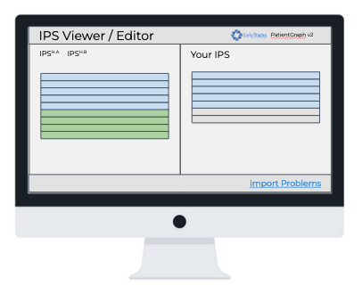



ePSUM
Heterogeneous and unstructured sources
2. GDPR: A data sharing solution respecting the patient privacy (hosting, consent, governance, therapeutic link)
3. Adoption by data users (care providers, researchers, managers).
CHALLENGES
SMART II - Production of general 'ePSUM standard' summaries
SMART I - FHIR Architecture and Network Level Data Governance
SMART II.4 - Use of data for primary and secondary use
ePSUM^{H.A}
Primary Use
Patient Summary Viewer
Viewer / Editor of patient summaries (both local and shared) with a UX designed to practitioners.
Hospital A
FHIR Repository
ePSUM^{H.B}
Hospital B
FHIR Repository
SOLUTIONS
ePSUM^{H.C}
FHIR Repository Central
Hospital C
FHIR Repository
Secondary Use
CDW- Clinical DataWarehouse
OMOP-CDM – Research database (anonymised data)
ePSUM^{H.D}
ePSUM data sharing architecture
Hospital D
FHIR Repository
Extension oncology – Breast Cancer
Notes:
Solution: Décrivez votre solution. Expliquez comment votre projet résout le problème que vous avez mentionné. Mettez en valeur ce qui le distingue ou le rend unique.
Challenges: Décrit les défis qui doivent être résolus;

Slide 4
Closing Statement
ePSUM
Health Data Sharing
(IPS – Patient Summaries)
Standardization and structuration of information (FHIR / SNOMED CT)
GDPR Compliant
Health Data Quality Control
User Adoption / Change Management
ePSUM will make it possible to
create and share patient summaries
respecting international and Belgian standards
for the benefit of the patients and all healthcare stakeholders
within the Elipse network.
Notes:
Concluez votre argumentaire en résumant les principaux points et en réitérant le message clé. Laissez une impression finale mémorable.

